Slide 1
2014
Dorman HD Solutions
© 2013 Dorman Products, Inc. Contains confidential and proprietary information of Dorman Products.
Information contained herein is intended only for the recipient(s). Any disclosure, copying, or distribution is strictly prohibited.

Slide 2
Agenda
Dorman Overview
Product Overview and Updates
New Parts - Available Now
New Parts - Coming Soon
Marketing Initiatives / Awareness
Retail Packaging
Sales Tools
Awareness Initiatives / Advertising

Slide 3
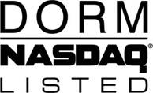
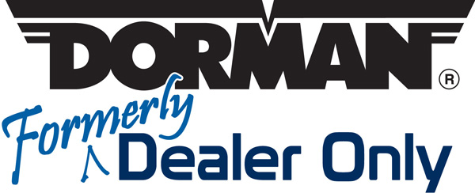
Dorman Snapshot
Founded in 1978
NASDAQ listed since 1991: DORM
Leading Aftermarket supplier of Formerly ‘Dealer Only’ Parts
Sales - $630 million annually
> 133,000 SKUs
> 130 product lines
HD Solutions offering launched in January 2012
Unique Business Model:
“New-to-the-Aftermarket”
International Sourcing Expertise
Strong Engineering and Quality Focus

Slide 4
New Product Development
What We Do
IDENTIFY, DEVELOP and INTRODUCE commonly replaced “Dealer Only” products to the aftermarket, providing an alternative source to the OE Dealer.
IDENTIFY PARTS WITH COMMON FAILURE PATTERNS and develop solutions that offer better designs, improved materials and greater reliability.
STAY DYNAMICALLY ENGAGED in the marketplace. Dorman’s Ideation Team is devoted solely to customer relations and new product generation.
Notes:
Product “Ideation” Team
Driving Force of New Product Development
Idea Managers, Tech Services, Field Analysts, Idea Management
Avenues of Idea Generation
Field Council, OE Relationships Parts & Technicians
Customer Sales and Counter Personnel, Internet Monitoring (Blogs)
Field Visits, Web Site, Lost Sales Reports

Slide 5
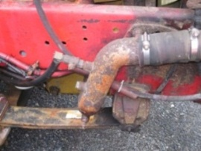
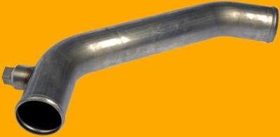
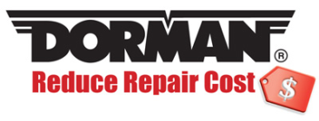
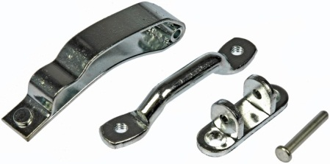
Dorman’s Added Value
Dorman Engineered
Parts re-engineered to eliminate original failure patterns
“Replace the Piece, Not the Assembly”
Reduce repair costs by replacing just the failed piece, not an entire costly assembly
Complete Kit Approach
Saves time and money by including everything needed to complete the job

Slide 6
Growing Revenue Opportunities
Current Aftermarket
Aftermarket with
Brakes
Drivetrain
Filters
Chassis
etc…
Window Regulators
Door Handles
Coolant Tubes
Fluid Reservoirs
Hood Springs
Wiper Transmissions
Radiator Fans
Hood Cables
Switches
Headlights
Air Door Actuators
and more…
How we do it….
Introduce Parts Not Currently Available in Aftermarket
Typically ‘Dealer Only’ Parts
Increase the Size of the Aftermarket
Expand availability beyond traditional categories

Slide 7
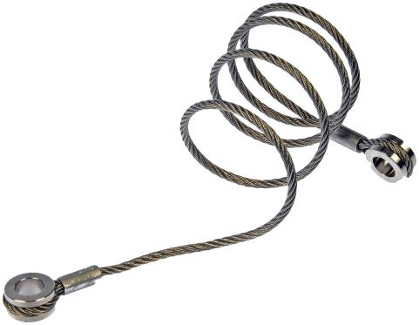
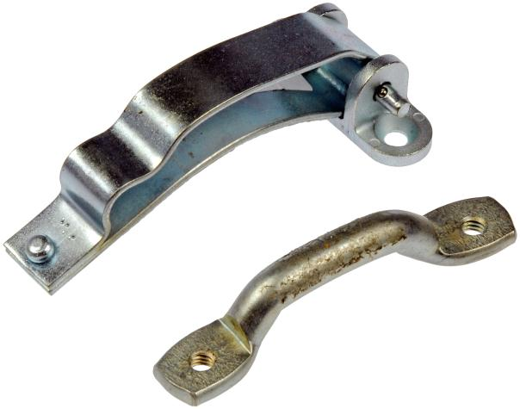
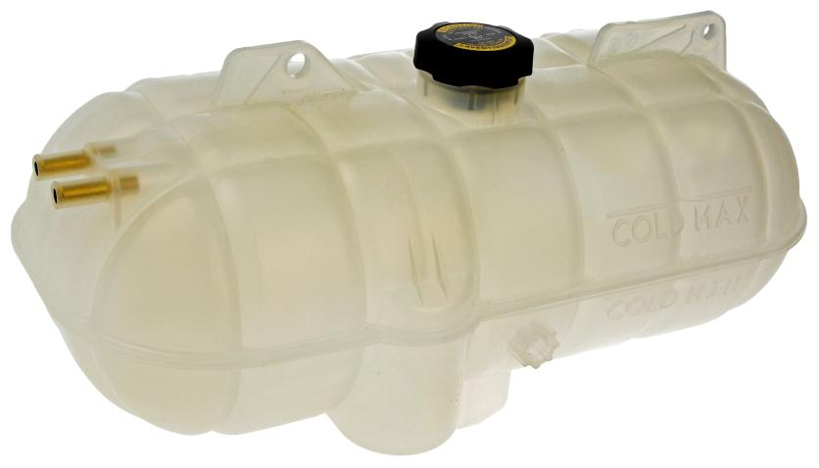
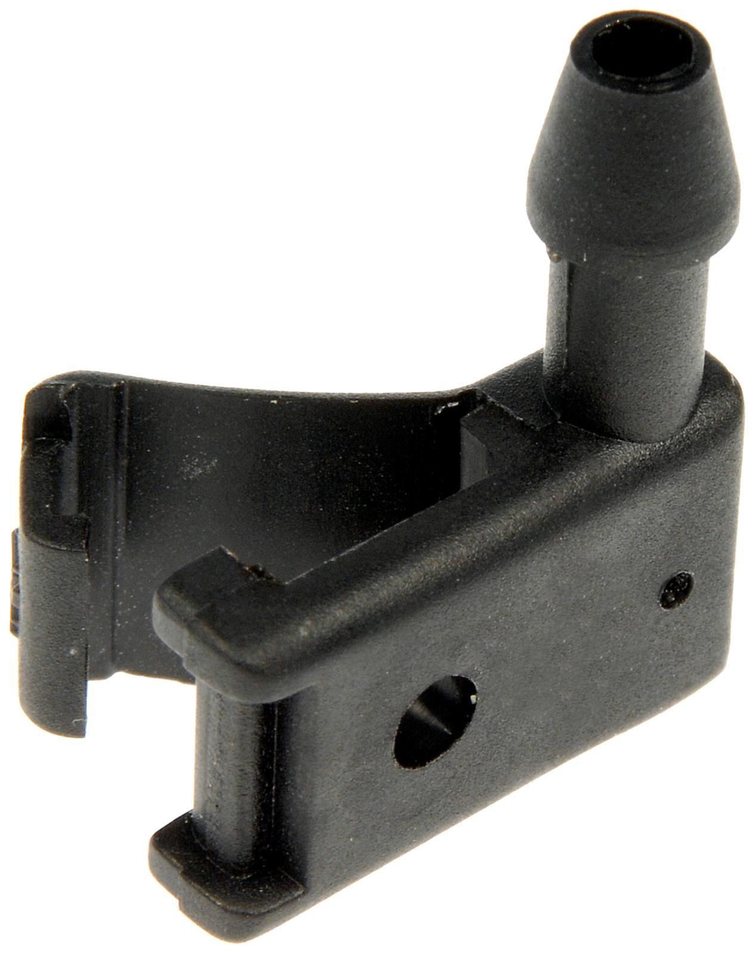
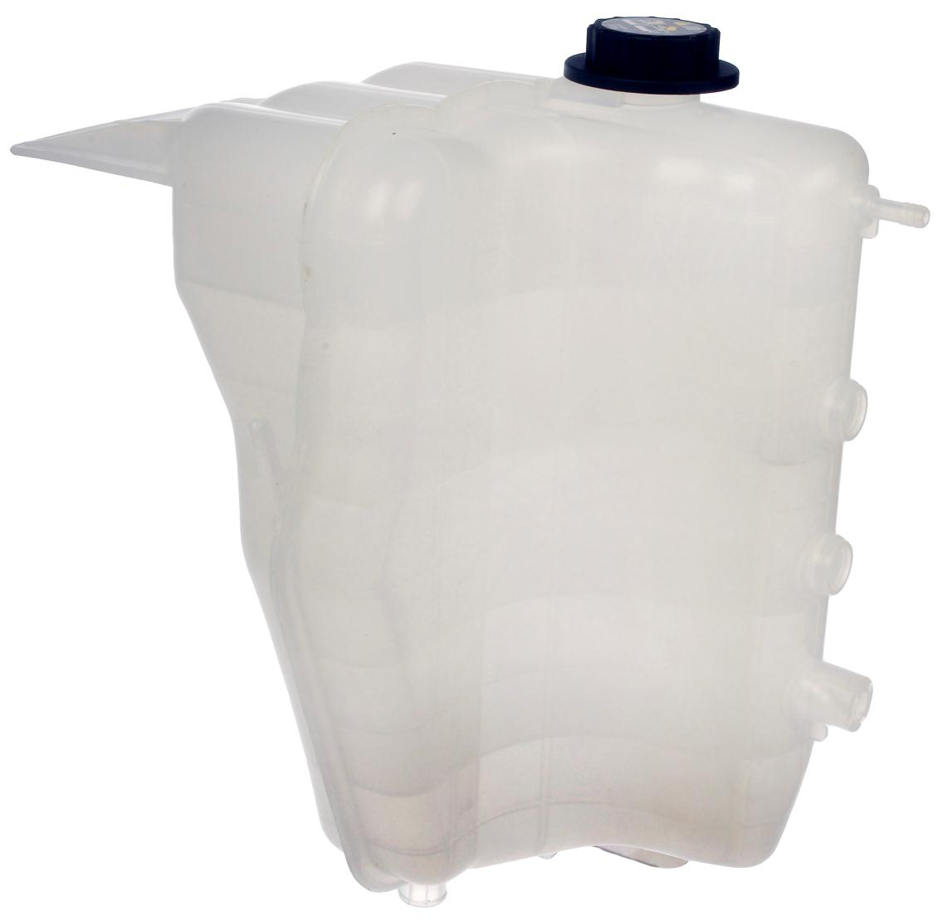
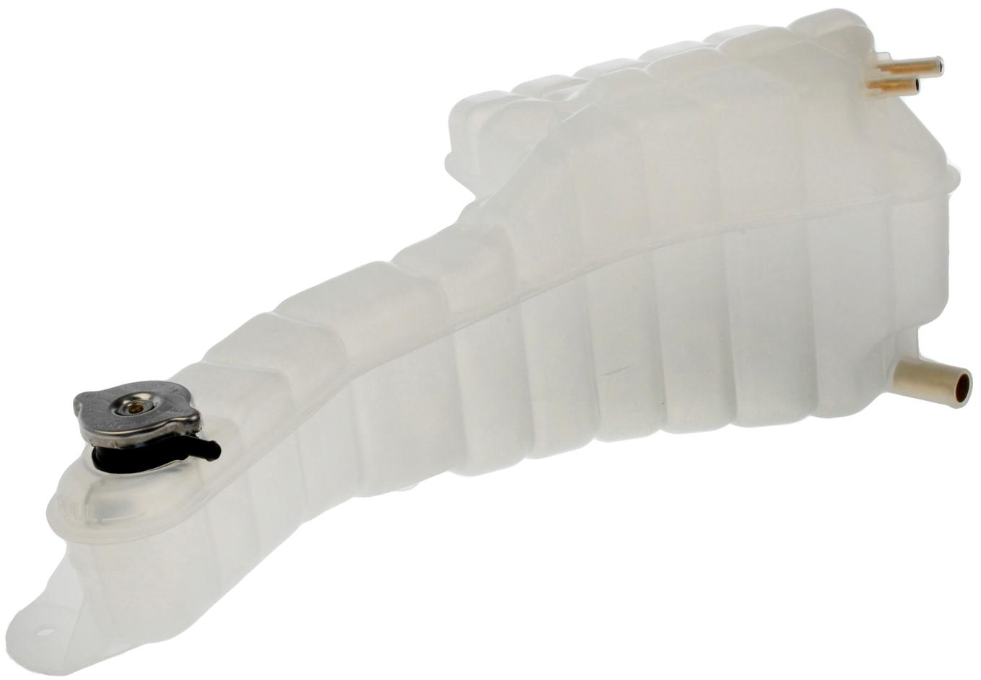
2013 Overview by the Numbers
Average Fill Rate: 97.0%
Number of 2013 SKUs Introduced: 57
Total SKUs Offered (as of 1/14): 324
2013’s Most Popular SKUs
1
2
3
924-5402
Hood Cable
Peterbilt
Pop Code: A
924-5401
Door Check
Peterbilt
Pop Code: B
603-5201
Fluid Reservoir
Freightliner
Pop Code: B
4
5
6
924-5403
Wiper Nozzle Kit
Peterbilt
Pop Code: A
603-5103
Fluid Reservoir
International
Pop Code: D
603-5202
Fluid Reservoir
Freightliner
Pop Code: B

Slide 8
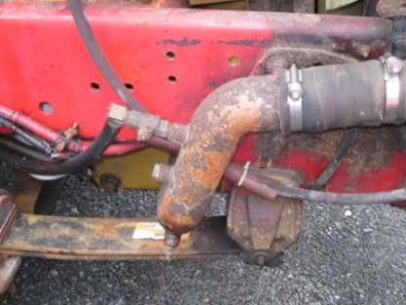
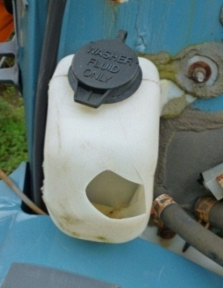
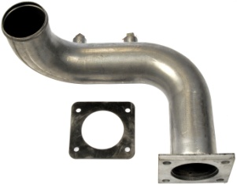
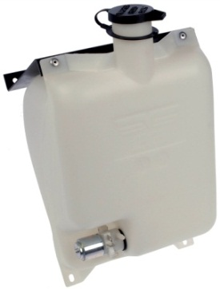
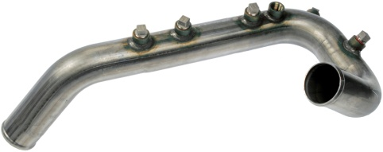
Product Offering
Coolant Tubes
High replacement rates due to:
Poor design
Low-grade steel
Exposure to high temperatures from engine
Rust and corrosion
Engine vibrations cause parts to fatigue
Fluid Reservoirs
High replacement rates due to:
High temperatures from the engine
Melt materials
Warp bottles
Vibrations from the engine
Mounting points wear and break
Bottles can crack over time
Material upgraded to stainless steel
Reservoirs feature improved clear design that eliminates indicator ports

Slide 9
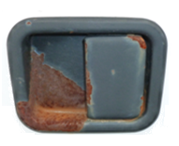
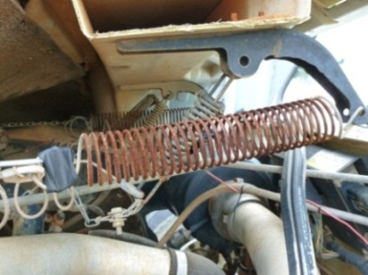
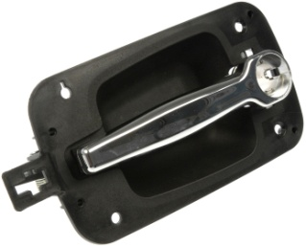
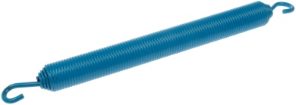
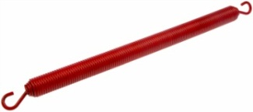
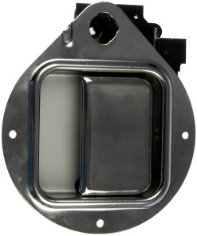
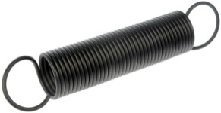
Product Offering (continued)
Door Handles
High replacement rates due to:
High number of VIO
General wear and tear
Rust and corrosion from exposure to elements
Hood Springs
High replacement rates due to:
High number of VIO
Exposure to elements
Extremely rust prone
Wear and tear
Opening and closing of hood causes part to stress
Springs color coded
for easy identification

Slide 10
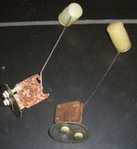
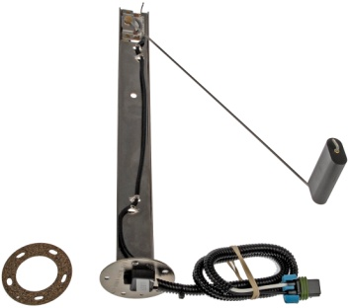
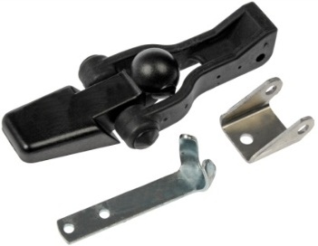
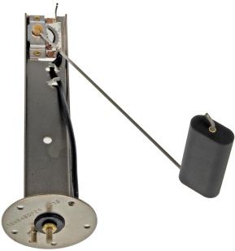
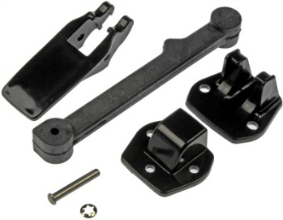
Product Offering (continued)
Fuel Senders
High replacement rates due to:
Fuel can “gel” and seize level arm
Corrosion
Additives in the fuel can eat away at materials
Vibrations from driving can damage part
Hood Latches
High replacement rates due to:
High number of VIO
Rubber dries out and fatigues
Wear from over stretching
Mounting plates rust
Material upgraded to stainless steel

Slide 11
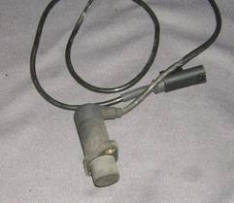
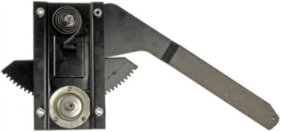
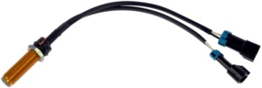
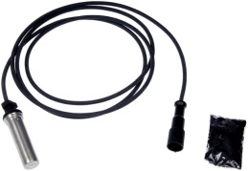
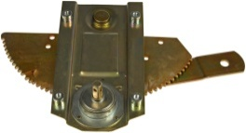
Product Offering (continued)
Speed & Tachometer Sensors
High replacement rate due to:
Vulnerable to road debris
Exposure to the elements damages electrical components
Ice seizes magnet and impairs accuracy
Window Regulators
High replacement rates due to:
Rust and Corrosion
Cable wear
Motor failure
Gear teeth wear over time
Window channels not maintained

Slide 12
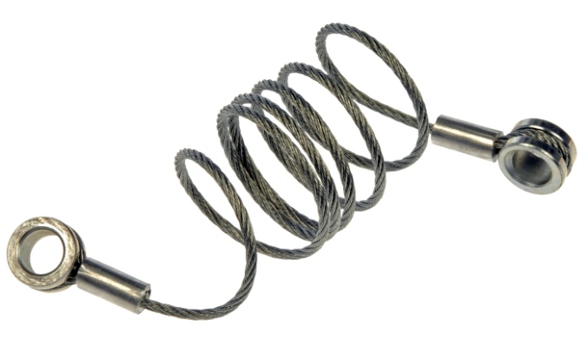
Product Offering (continued)
Hard to Find
High movement level at dealerships
“Every part has a story”
Peterbilt Door Check Kit 924-5401 2005-87
357, 367, 375, 377, 378, 379
Peterbilt Hood Cable 924-5402
2005-87 357, 367, 375, 377, 378, 379
Common Causes of Failure:
Normal wear and tear
Corrosion
Common Causes of Failure:
Corrosion
Overextension of hood
One kit includes four parts the dealer only offers separately.
Designed with heavier gauge cable and stainless steel.

Slide 13
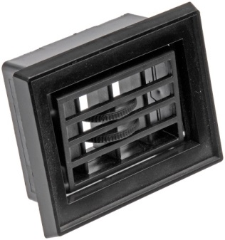
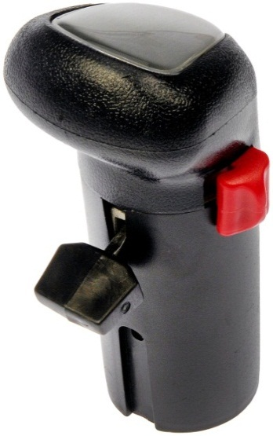
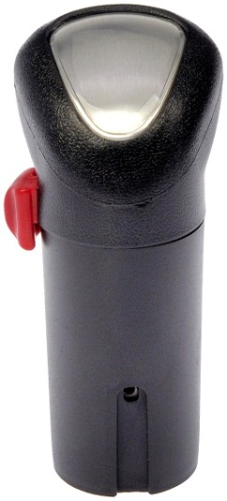
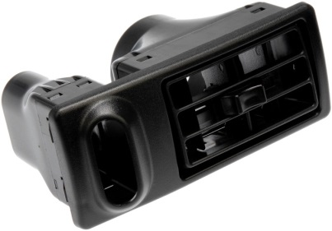
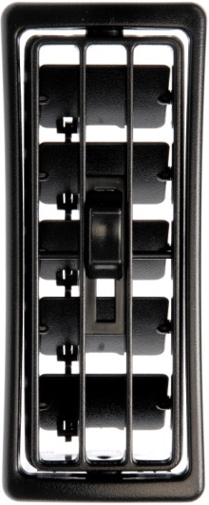
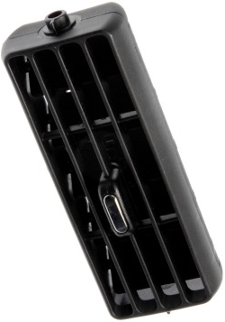
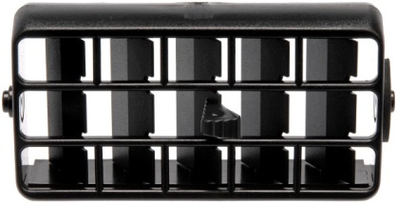
Product Offering (continued)
HVAC Vents
Applications and Coverage:
International, Freightliner, Kenworth, Peterbilt and Western Star
Coverage for 13 different models
Air Shift Knobs
Applications and Coverage:
11 popular SKUs for Eaton/Fuller transmissions
Coverage for “Super 10,” 13-speed, 15-speed, 18-speed and Hi\Low gearbox range

Slide 14
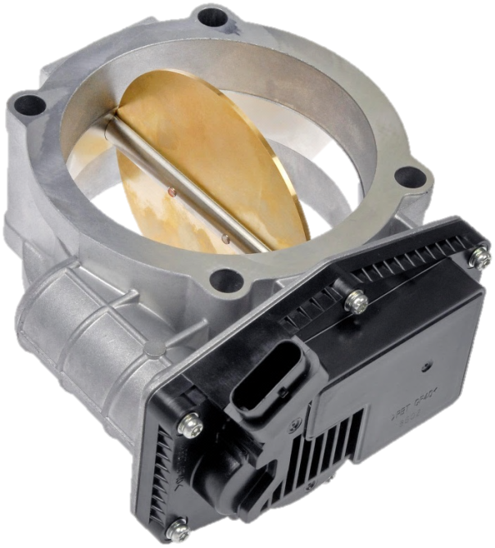
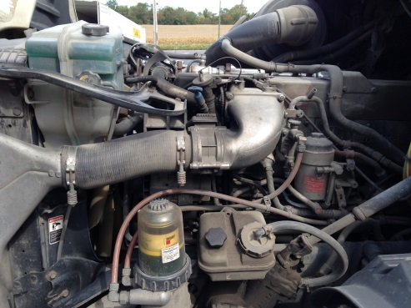
New Products: Available Now!
Detroit Diesel Throttle Actuator
341-5001
Detroit Diesel 60 Series, DD14, DD15, Mercedes Benz 4000
Electronic control of throttle body
Failure Modes:
Throttle sticks or is non-responsive
Throttle becomes inoperable
Failure results in illumination of the Check Engine Light

Slide 15
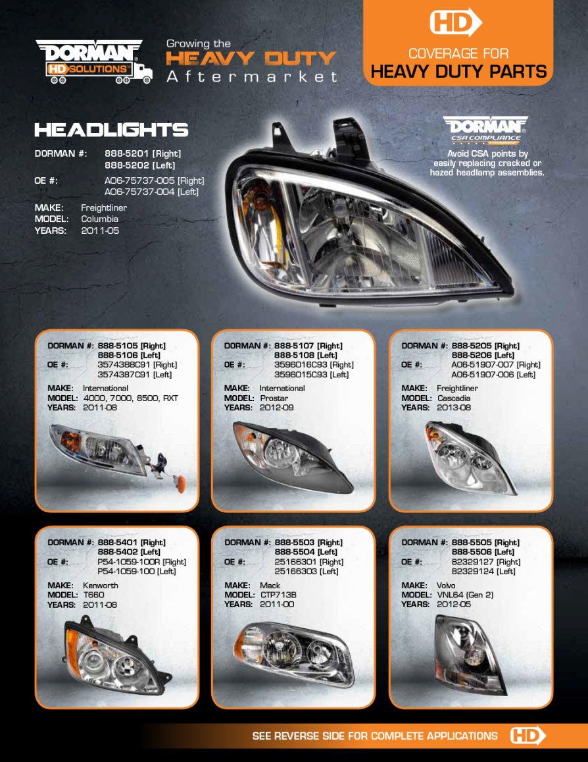
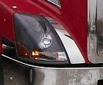
Product Offering (continued)
Headlights, Fog Lights & Bezels
Location on Vehicle: Front of vehicle
Reasons for Failure: Collision damage, lenses fade and haze
Symptoms of Failure: Headlights not illuminating, cracked or hazed
Dorman Coverage: 36 SKUs
Dorman’s Selling Advantages
Exclusive Aftermarket Offerings
Avoid CSA Points by easily replacing cracked or hazed headlight assemblies

Slide 16
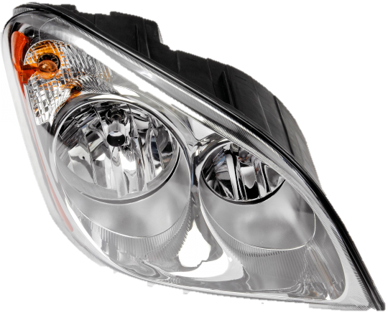
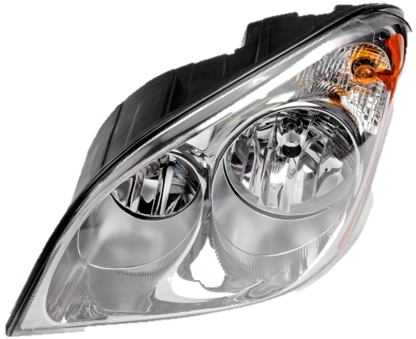
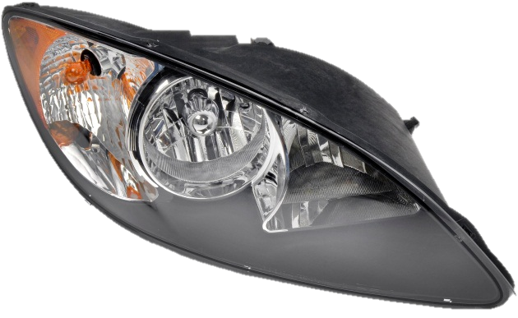
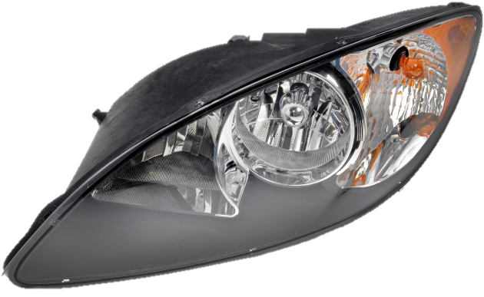
New Products: Available Now!
Cascadia and Prostar Headlights
Dorman #:888-5205 [Right]
888-5206 [Left]
OE#: A06-51907-007 [R]
A06-51907-006 [L]
Freightliner Cascadia 2012-08
Dorman #:888-5107 [Right]
888-5108 [Left]
OE#: 3596016C93 [R]
3596015C93 [L]
International Prostar 2012-09

Slide 17
New Products: Available Now!
Dorman# 242-5201
OE# A17-19112-000
Freightliner Cascadia 2013-08
Dorman# 242-5202
OE# A22-65847-000
Freightliner Columbia 2008-00
Dorman# 242-5502
OE# 251662748, 6MF580M
Mack Vision 2001-98
Dorman# 242-5513
OE# 8083095
Volvo VN Series 2003-96

Slide 18
New Products: Coming Soon!
Door Latches
• Initial offering to include 10 SKUs
• Peterbilt and International applications
• Great compliment to Dorman’s Door Handle program
Steps
• Initial offering Includes 19 SKUs
• Popular applications for Mack, Volvo, Freightliner, International & Paccar
Dip Sticks
• Initial offering Includes 10 SKUs
• Popular applications for Mack, Volvo, & Freightliner

Slide 19
New Products: Coming Soon!
4 New Fluid Reservoirs
Freightliner: Cascadia applications
International: 4000 series
Volvo: VN & VNM Series (2 SKUs)
8 additional in Development

Slide 20
New Products: Coming Soon!
GM Steering Shafts
C5, C6, C7 and C7500
Fluid Reservoirs
Power Steering
Washer Fluid
Surge Tanks
Collision Parts
Mirrors
Bumpers
Steps
Projects Currently in Development Queue
4 Heated Mirrors
2 Mirror Assemblies
8 Reservoirs
11 Fuel Tank Straps
6 Fuel Senders
7 Cab Handles
8 Hood Latches
3 Steering Shafts
10 Wiper Arms

Slide 21
Medium Duty Diesel Engine Parts Offering
100’s of High Demand SKUs:
Valve Cover Gaskets
EGR Coolers
Oil Coolers
Vacuum Pumps
Filter Caps
Coolant (D-Gas) Bottles
Exhaust Manifolds
Harmonic Balancers
New SKUs always in development
Backed by limited lifetime warranty
Dedicated website (DormanDiesel.com)
Awareness tools available
Product guides
National advertising
Digital advertising

Slide 22
Marketing Initiatives
Retail Packaging New!
You asked…we listened!
Launching with ~75 SKUs (more coming soon)
Bilingual content (English, Spanish & French)
Make called out on card front, models on back
Color coded to area of vehicle
Rollout beginning Q1 2014
Training Modules New!
Dorman University: an offering of web-based learning modules
Enrollment is free and easy (either online individually or as a group through Dorman Marketing)
Diesel Module: Available Now
HD NPDG Module: Available in February

Slide 23
Marketing Initiatives
Slack Adjuster Counter Display (available now)
Exclusive cost saving kit for trailers with Haldex ABA and S-ABA Slack Adjusters
Versatile display helps illustrate the unique kit benefits
Email Marketing Campaign
Over 1,500 participants
675 added in 2013
Monthly new product alerts
40+% open rate
Are you signed up?
Notes:
40% open rate for HD BTFTK is VERY GOOD. Average ‘good’ email marketing open rate is 10%. It indicates that our HD BTFTK audience is an engaged one.

Slide 24
Growing Awareness – The BTFTK Program
Be The First To Know Program (BTFTK)
Streamlined new product communication (either direct or electronic)
Participants in the BTFTK program automatically receive new product announcements and marketing alerts
Notes:
24

Slide 25
Awareness Tools
Makes Fliers
Targeted and cost effective
Easy to customize with WD logos
Updated and posted on the website
New Product Guides (Shipping Now!)
Replaces original catalog
New to the Aftermarket, coverage by OE make, Medium Duty Diesel section
Available in print and as digital flipbook online
Monthly New Product Announcements
Monthly alerts for all new product introductions
Delivered via email and web
Includes link to file with all new product set up data
DormanHDSolutions.com
Exclusive Y\M\M search (powered by Google™)
Product info, videos, fliers, live tech support and more!
Hosted over 91,000 unique visitors in 2013

Slide 26
Awareness Tools
Trade Shows
H.D.A.W. Jan 27-30 Las Vegas
Work Truck Show Mar 5-7 Indianapolis
T.M.C. Mar 10-12 Nashville
Trade Advertising
Truck Parts & Service
Fleet Owner
Digital\Web Banners

Slide 27
THANK YOU! We look forward to helping you grow your business!

